Slide 1
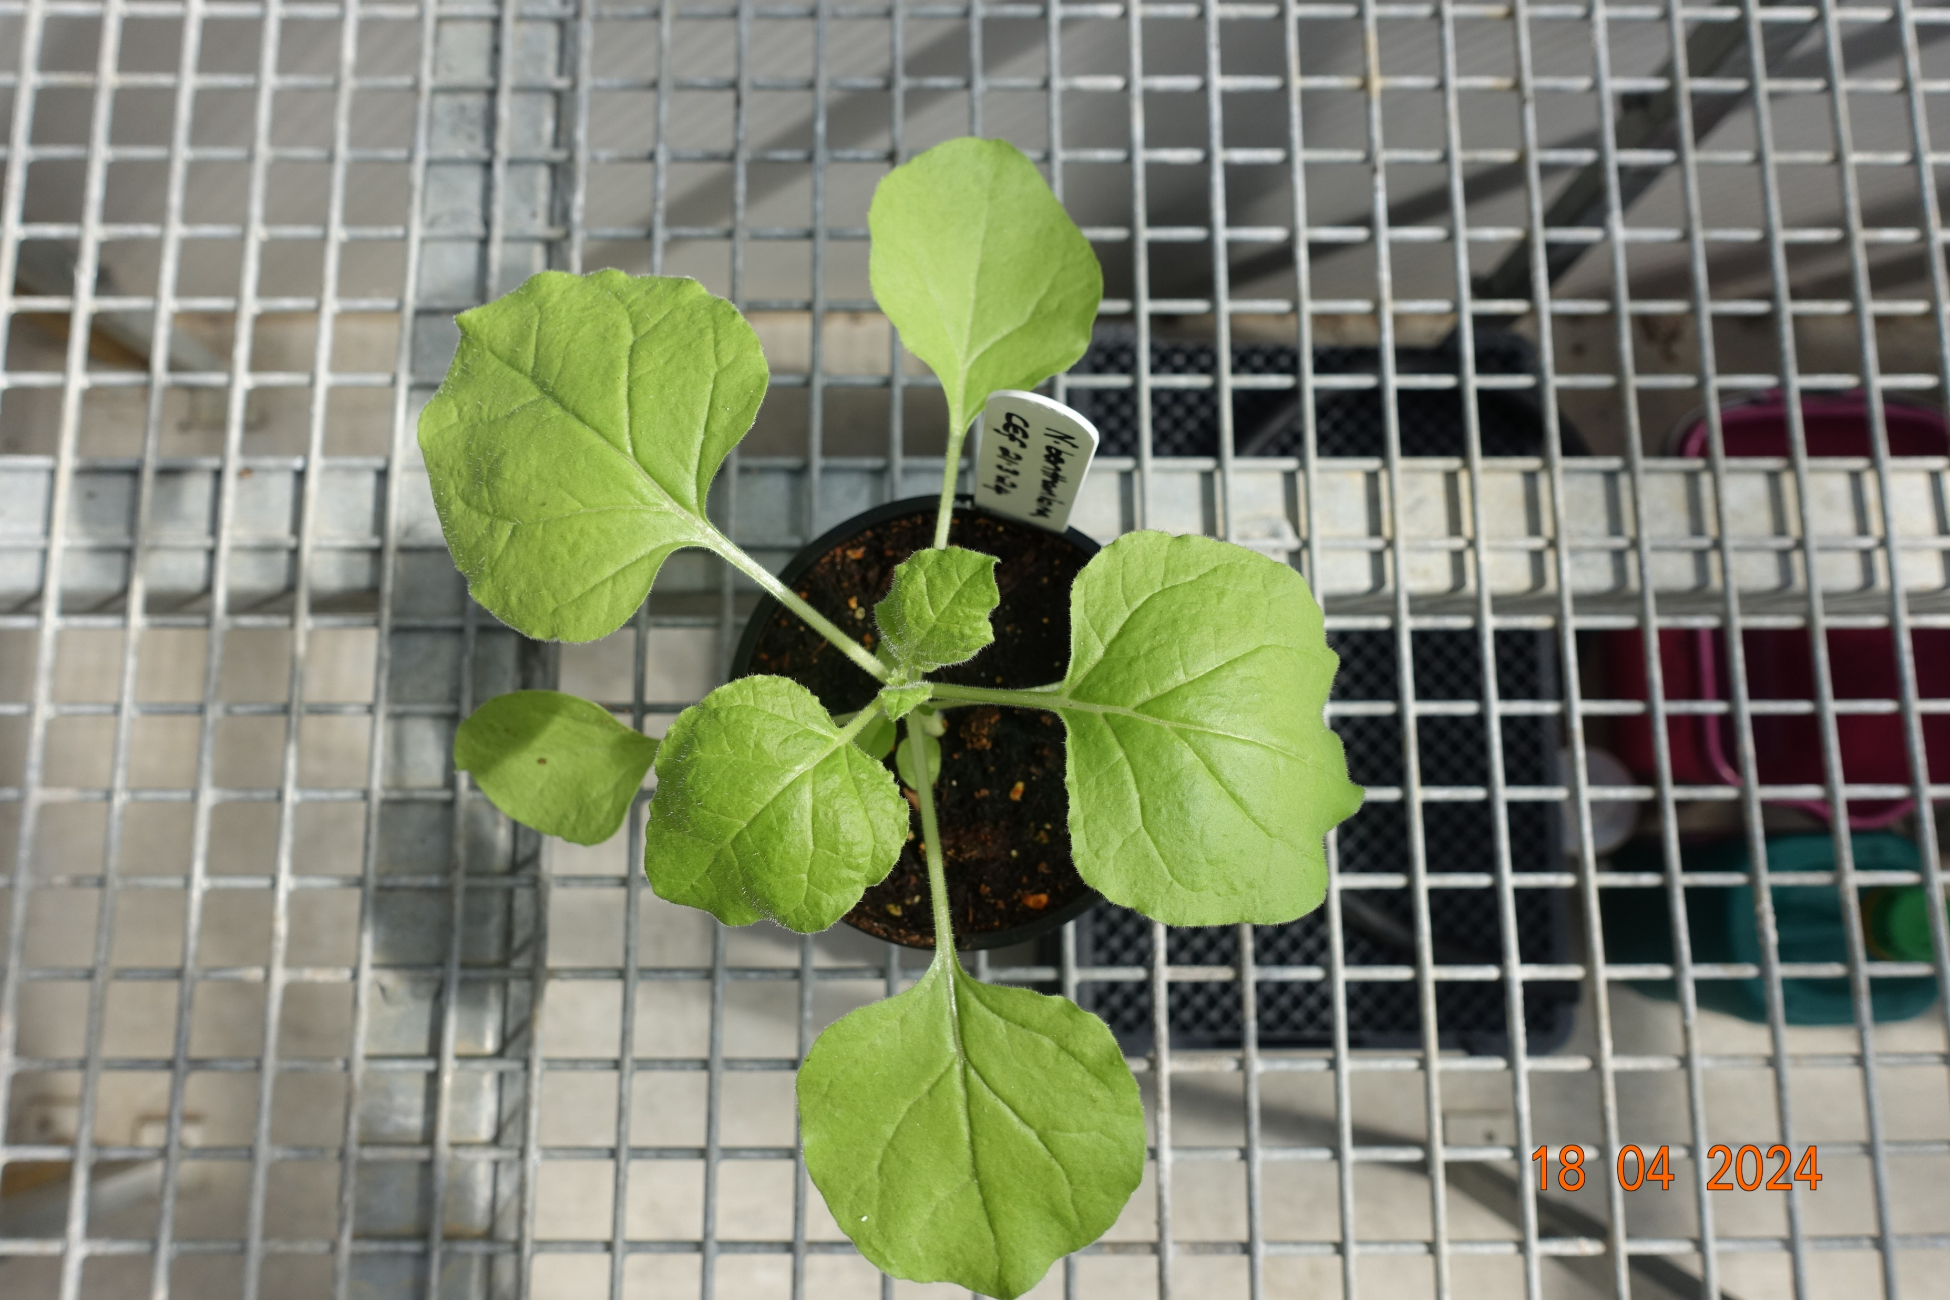
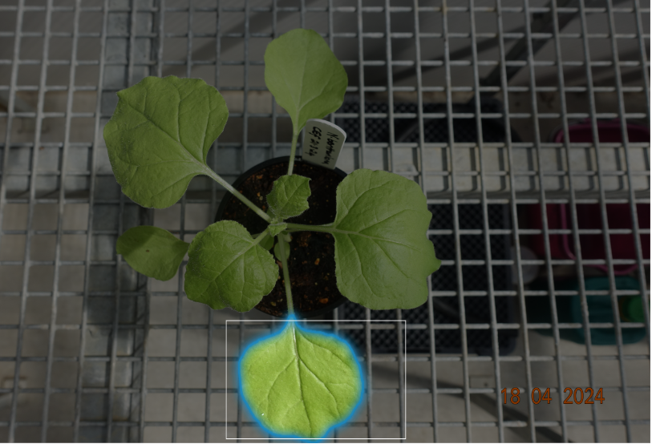

Using SAM model
Hosted in
server
Classified disease
Using Disease
detection tflite
model

Slide 2
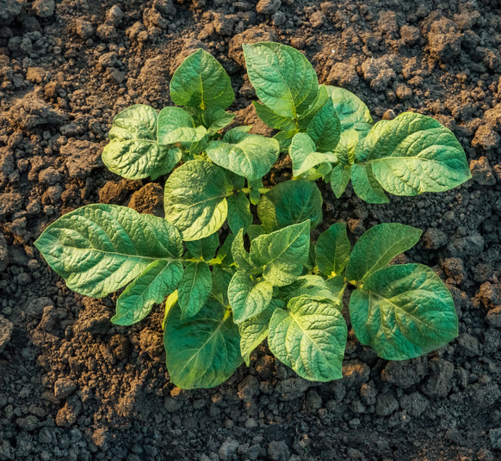
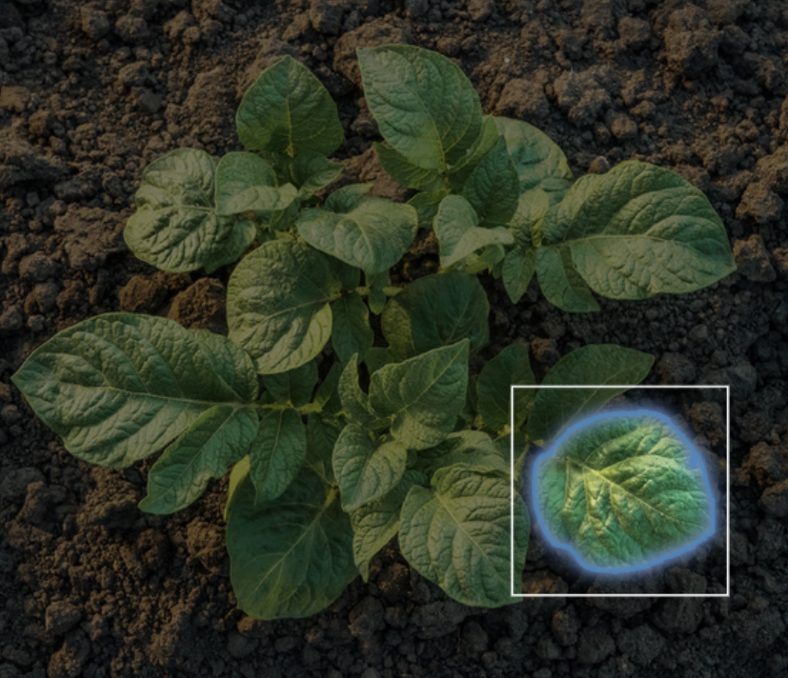

PlantDis – A Plant Disease Detection App
Top down image
User drawing
bounding box
Image after
segmentation (SAM)

